Slide 1

Tasty Bytes
High Traffic Recipe Prediction
issaiass@hotmail.com

Slide 2

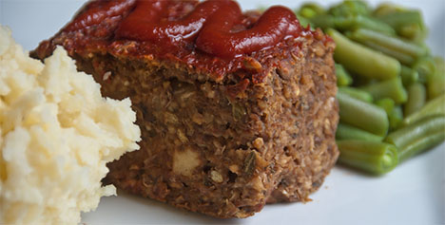
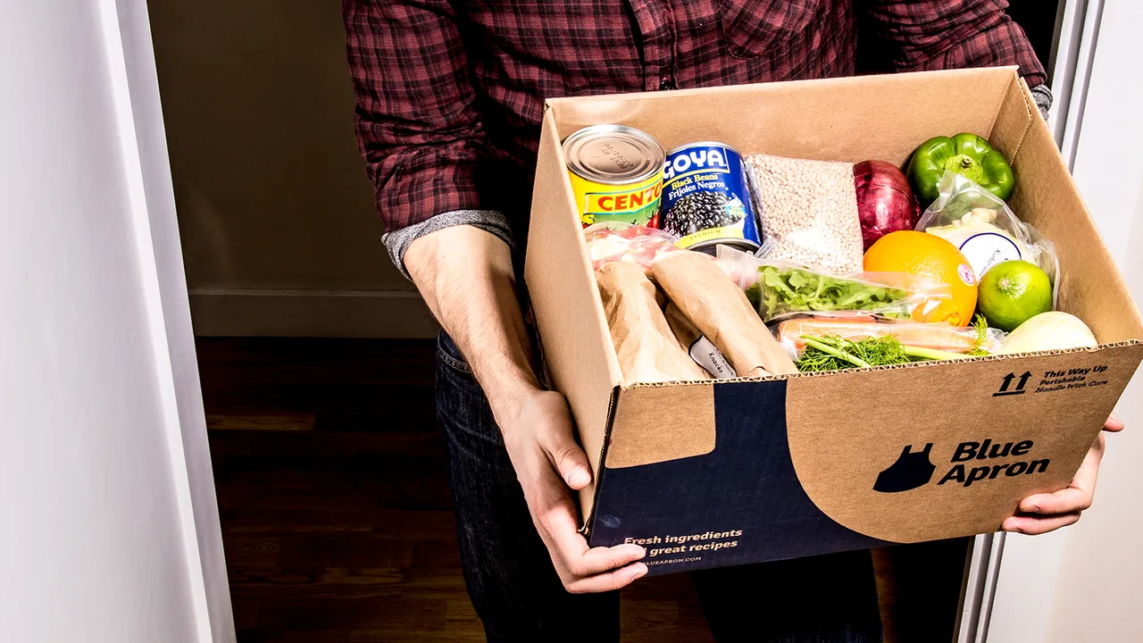
About the company About the Goals
2020:
Founded in the midst of COVID pandemic
Started from inspiration and provide it
Initially started as a recipe search engine
Help people to find ways to use up limited supplies at home
2022:
Consolidates business
Monthly subscription:
Meet a full meal plan
The plan ensures a balance diet and meeting health too
Budget scalable for recipes
Premium subscription
All in monthly subscription
Deliver ingredients to your door
Predict which recipes will lead to HIGH TRAFFIC
Correctly predict traffic recipes 80% of the time

Slide 3
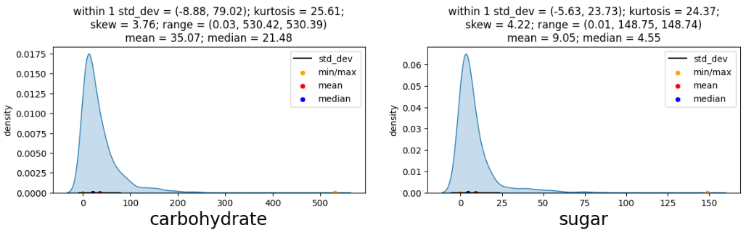
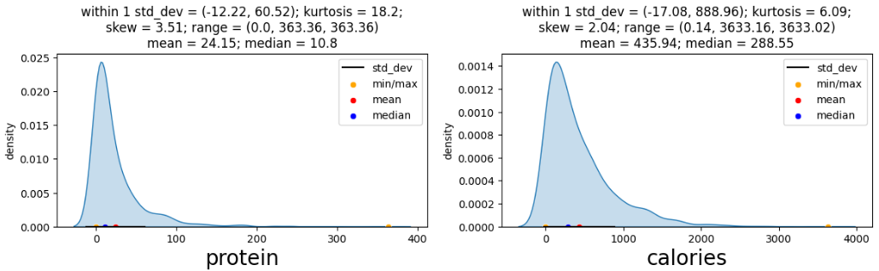
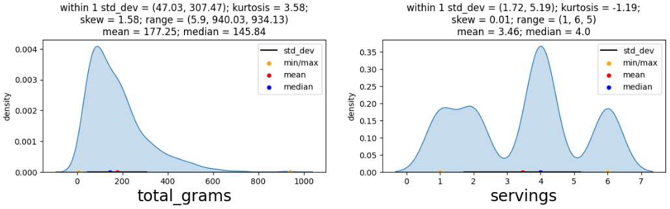
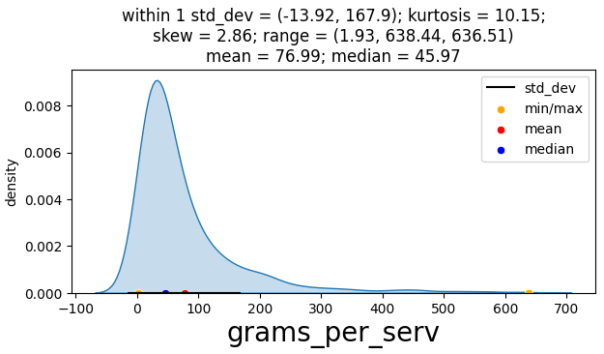
Outcomes
Outcomes
People tends to select recipes with low proportion of calories, protein, carbohydrates, sugar, etc.
Very low rate to pass 2kcal
Recipes over 4 servings
Data present right skewness

Slide 4
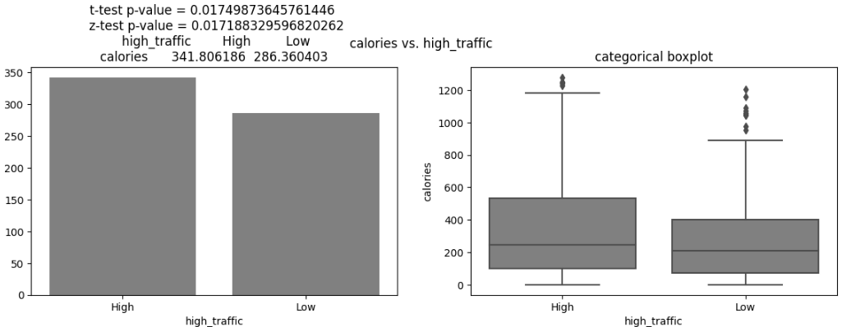
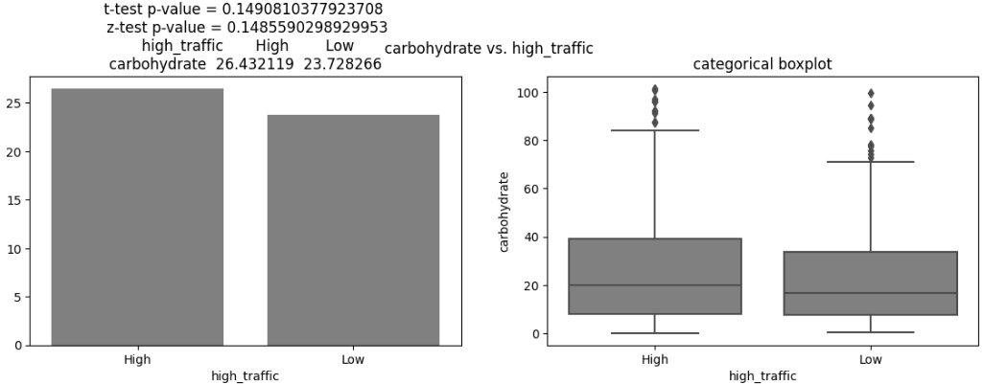
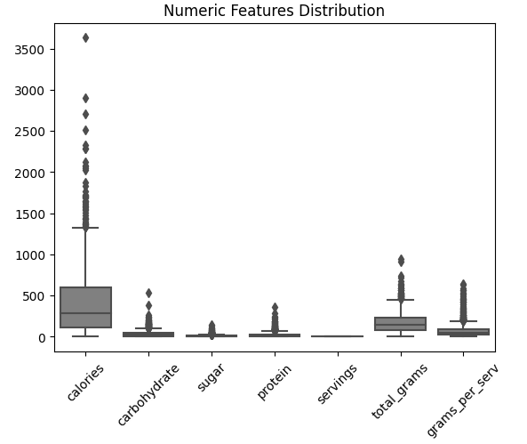
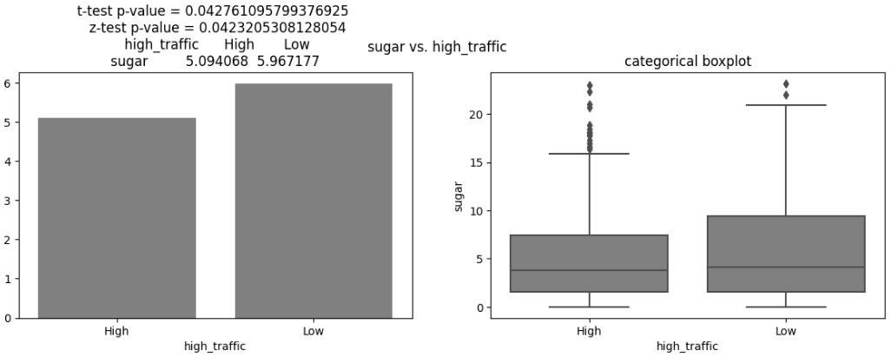
Outcomes
Outcomes
Sometimes high traffic data presents more relevance for the variable to study using the t-test and z-test

Slide 5
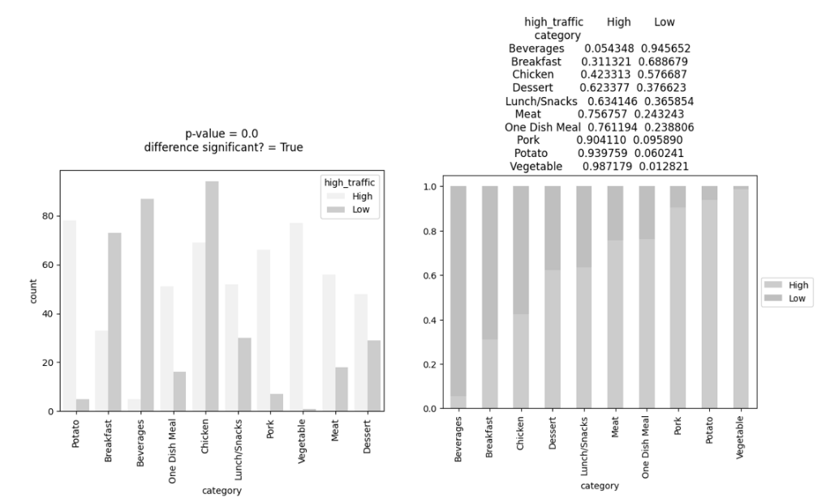
Outcomess
Vegetables, Potato and Chicken are dominating the high traffic
One Dish Meal and Breakfast are not as common selection and has less than 42% of its traffic High.

Slide 6
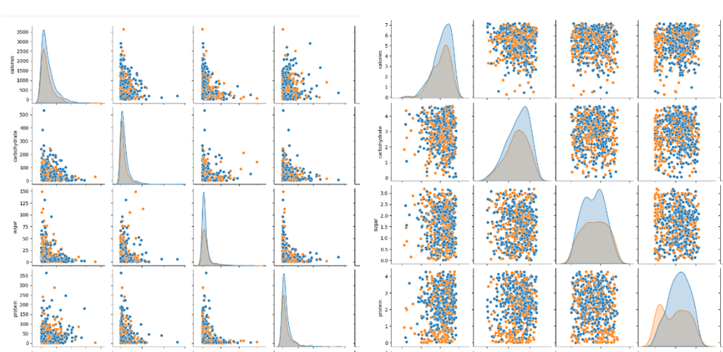
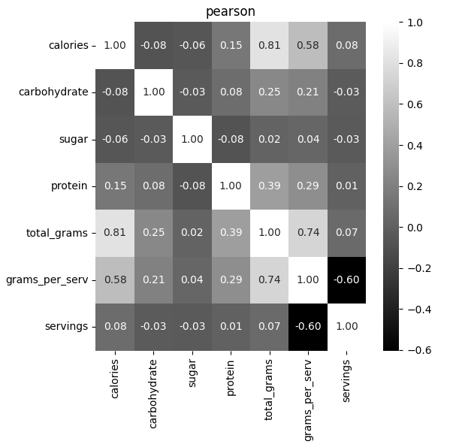
Outcomess
Some strong relationships on new features and common features of the dataset
After applied the log transformed to the majority of the numerical variables and check the correlation we saw some stronger relationships.

Slide 7
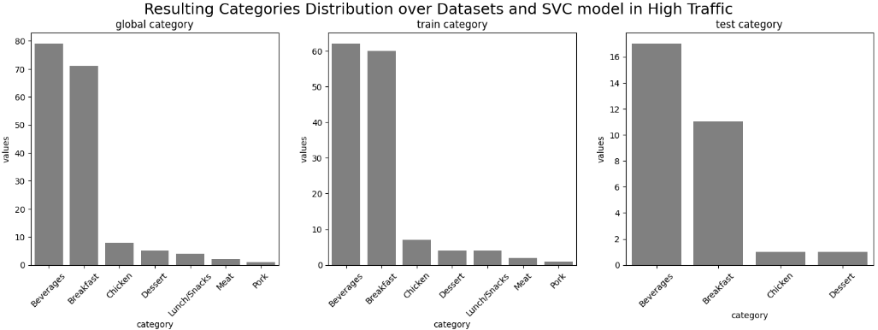
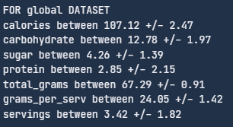
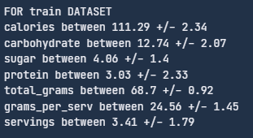
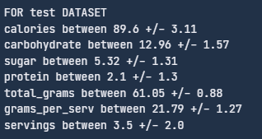
Outcomes - High Traffic (80% results)
High Traffic Recipes are more attractive for:
Beverages, Breakfast and Chicken
Recipes that have high traffic has less proportion of sugar, protein, carbohydrates, etc.

Slide 8
Business Metrics
The KPI selected is precision. The company wants a way to choose a favorite recipe that will be displayed on the web page. Our goal was to got over 80% of recipes and we achieved with both models but selected the SVC to give a test.
80% precision represents, as the results of the model stated:
170 recipes of the global dataset of 602
140 recipes over 481 on the training set
30 recipes over 121 on the test set.
Key Metric is Precision
LR (79.4%, 77.61%, 87.1%), AUC: 84.6%
SVC (83.5%, 82.86%, 86.7%), AUC: 78.5%

Slide 9
Recommendation
We can save the model and make some runs over real data over time. The model effectively could detect with a precision above the 80%+ correctly the High traffic recipes.
For improving the model
For measuring our KPI (precision) we must log the predictions and compare in the next month to the results
Deploy the model using a common cloud platform like AWS Sagemaker
Make a dashboard with AWS QuickSight to gather insights of the features tracked month by month including the KPI
If cloud is expensive use common tools like Gradio or Streamlit for the dashboard and Heroku for deploy the AI model as a Service
Move the threshold value from 0.5 to get a higher precision (sacrifying recall)
Validate the future predictions and mark them to gather again more data for training.
Test other models, fine tune it with a gridsearch, do more feature engineering.

Slide 10
Thank you

